Slide 1



ABAP on Hana s/4 Hana Training
Day 5
contact@anubhavtrainings.com

Slide 2

Agenda – Day 5
Performance Guideline for ABAP CODE
Describing SQLM (SQL Monitor)
SQLM Architecture
Static check with SQL performance
SQL performance Tuning work list monitor ( SWLT )
OIA Scenario ( Open Item Analysis )
Articulate Requirement for OIA
Execute OIA on ABAP
Aggregation Scenario

Slide 3
Performance Guild line for ABAP Code
Keep the Result set Small
Discard Records which are not required using WHERE Clause ,Avoid Selection on large tables w/o Specifying Key ,Use Having Clause even with Group By
Minimize Number of Data Transfers (hits)
Avoid Using Nested Selects , Loop at itab – SELECT
Use Joins, Subqueries and FOR ALL ENTRIES
Use Array Operations
INSERT INTO tab FROM TABLE itab.
Minimize Amount of Data Transfer
Avoid using SELECT *
Use Aggregation functions and case Expression
Don’t Create Search overhead on DB
Use Full Text Search
Don’t run jobs which are long running and creating deadlocks for DB
https://blogs.sap.com/2014/06/27/unleash-the-power-of-sap-hana-from-your-abap-custom-code-accelerate-your-custom-reports-like-never-before-detect-and-prioritize-your-custom-code/

Slide 4

Question
Imagine, Your company adapted all custom code and now they are on SAP S/4HANA. Your manager asks that “Can you improve performance now leveraging HANA as you are an ABAP on HANA Expert”
Which is that code I need to improve as in a typical SAP system we have 20-50k objects
We need to find most relevant objects in the system which requires improvement
The objects which are used the most by business
Which is the system which gives me correct picture of the most used object D,Q,P?
Production
A production system consist of 6k concurrent users, 50k ABAP statements every day, 130 k SQL Requests, 140B Records. If use some kind of tracing tool, will my basis allow it? Will it by chance cause any performance problems? What options do I have to find the MOST used Code in the PRODUCTION system?
ST05 & SAT – Cause an overhead on the system, it’s a developer tool, it will slow down execution.
STAD & ST03 – System level tools used by BASIS to aggregate performance (High-level), There is no drill down possible.
ST04 – SQL Trace gives us comprehensive data but cannot tell the entry point and also captures huge no of calls.

Slide 5
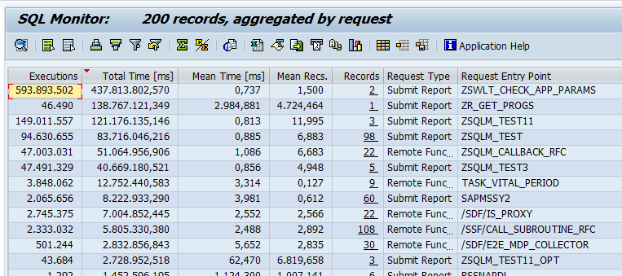
SQLM ( SQL Monitor )
This is a tool developed by SAP and available since NW 7.4 in all systems to monitor SQL statement performance in terms of DB Time, avg. time taken per request, DB Records, Iterations, over all consumption.
This is the recommended tool to be used in ABAP On HANA systems (production) w/o affecting performance.
Most expensive request entry point (Transaction, BG Job, Program, Report) In terms of DB Time
In these entry points itself, which SQL Query Dominates the SQL Profile
Most Expensive or Used Query in Whole System

Slide 6
SQL_M Architecture
When SQL Monitor is switched on
ABAP kernel logs information about DB accesses asynchronously via runtime monitor.
Monitoring data is moved periodically via a batch job to specific database tables.
SQL Monitor transaction reads data from these database tables.
Work Process
SQL Monitor Transaction
Runtime Monitor Data
Database Interface
Async.
Batch Job
SQLM Tables
Application Tables

Slide 7
SQL Performance Worklist Tuning
The SQL Performance Worklist Tuning (transaction SWLT) enables you to find ABAP SQL code that has potential for performance improvement. This tool combines information from static ABAP code scans that normally run in a test or quality system with runtime data from the SQL Monitor that typically originates from the productive system. Based on data records collected by the SQL Monitor, the SQL Performance Tuning Worklist automatically creates a worklist and allows you to rank the findings according to specific performance issues and their business relevance.
Findings from
SCI/ATC
Which are all
violation of
guidelines
SQLM tool for most
used and domination
SQL statements
What need to be fix?
Performance_DB : is the Check Static Variant.
Priorities

Slide 8
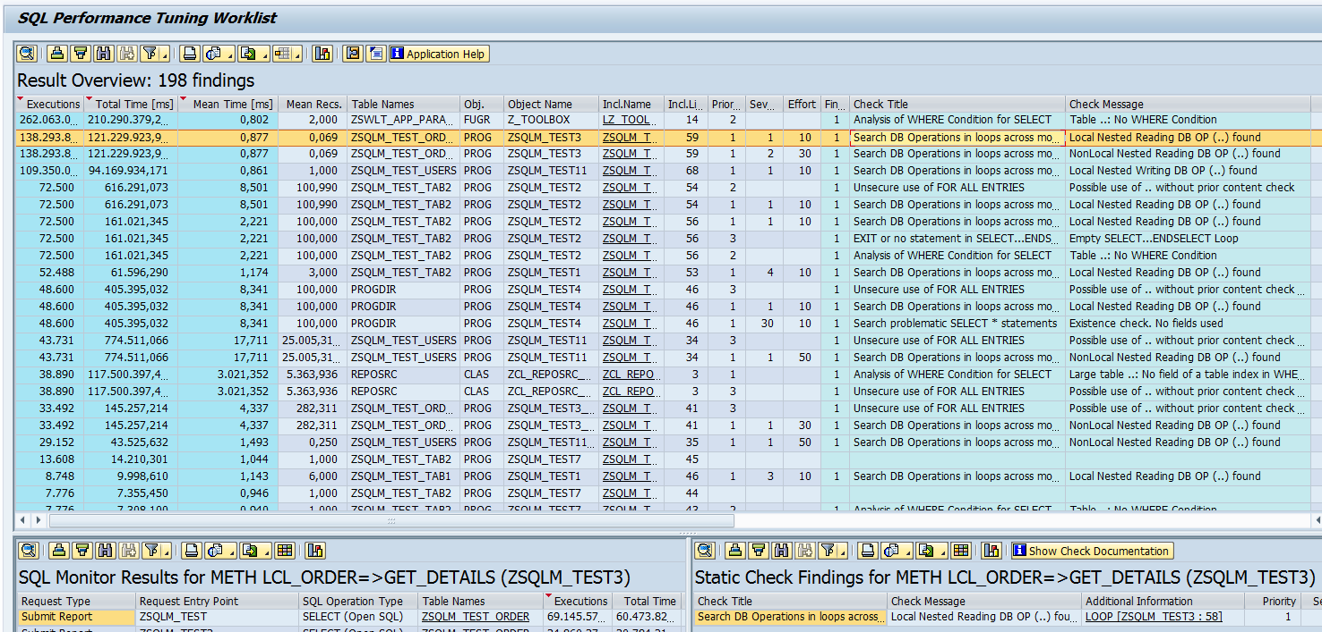
SQL Performance Tuning Worklist - Usage
Transaction SWLT provides a combined view with flexible navigation options
1
Ranked worklist
SQLM Data Different request entry points
ATC Results Detailed check results
2
3

Slide 9

Exercise 3
Performance DB Check

Slide 10

OIA Scenario - Open Item Analysis
Mr. James (Account Receivable Accountant)
Mr. James is a 63 year old men, working in our Toronto office since last 30 years of service. He lives in downtown near the lake in his own 680 Sq yard home. He is a proud father of 2 girls which are studying. And drives Audi A6.
He is a seasonal Skiing player.
Cash has a very important role in a company for running business. It is in the best interest of the company to collect the pending dues from their customers as soon as possible. By putting this Cash back into the system, the company can execute is ambitions and expansion plans faster. So Mr. James is here working as an account receivable accountant, his job is to manage customer accounts and remind them for their unpaid bills when the bill amount OR the average days for unpaid invoices are passed. Classify these customers based on their ability to pay pending bills.

Slide 11
Articulate Requirement for OIA
Create a DB table which stores the customizing – Threshold – Days, Amount
How long on average basis the invoices are outstanding – UNPAID
Invoices which are unpaid – SNWD_SO_INV_HEAD Payment_Status = ‘’
Calculate the average open days since when they are unpaid – Sum / Count
Business partners and company names for those invoice SNWD_BPA
Check the total gross amount of invoices which is open in “common currency”
Invoice header to identify the unpaid invoices – SNWD_SO_INV_HEAD
For each invoice read the line items from SNWD_SO_INV_ITEM and convert to common currency.
Currency conversion based on customizing will be done for items
A total open amount will be calculated in common currency (gross_amount)
Business partner information to find which co. SNWD_BPA
Classify the customers which are at high risk
5. Dunning – Reminders / calls for making payment
COLLECT statement in ABAP.??

Slide 12
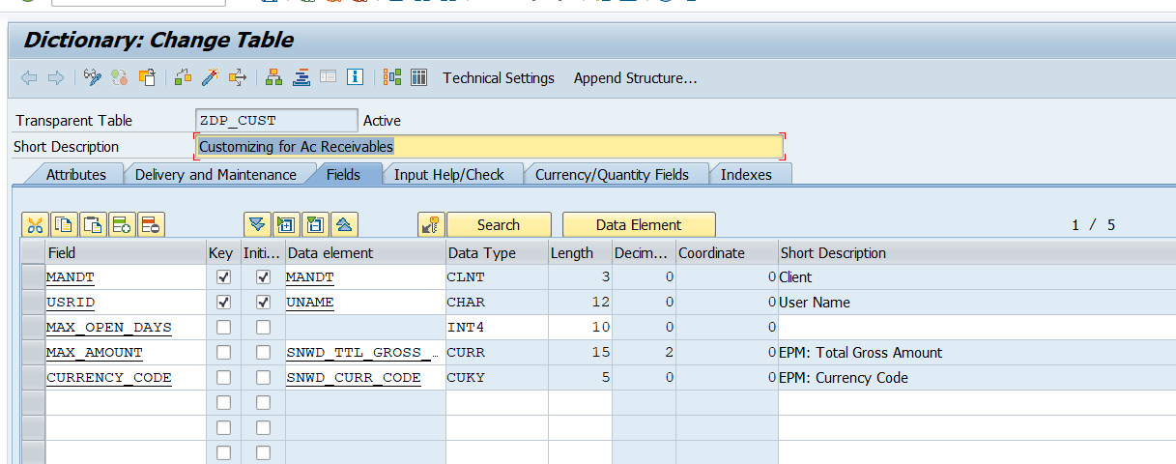
Custom Table for OIA

Slide 13

Exercise 4
OIA Scenario Code
Aggregation Scenario (OIA)

Slide 14

End of Day 5
Trainer: Anubhav Oberoy & Shubham Singh

Slide 15

Trainer: Anubhav Oberoy & Shubham Singh

Slide 16
THANK YOU
If you cannot do
great things, do small things in a great way.
Anubhav Oberoy & Shubham Singh
https://www.anubhavtrainings.com

Slide 17


We’re committed to empower you to be
Most Desirable Resource
through powerful training solutions.
We build the workforce of the future.
250+
Corporate Clients
30,000+
Learners Trained
25000+
Learners Placed
FREE WEBINARS
Sign up for free webinars with industry experts every fortnight!
Enroll Now!
Contact us today!
https://anubhavtrainings.com/

Slide 18




More from AnubhavTrainings.com

